Slide 1


Johnston Heights
Personal Project

Slide 2
At Johnston Heights…
Your Personal Project is worth two credits towards graduation
The majority of the project is SELF DIRECTED
You will receive some instructions and feedback through your Careers 10 teacher, who is your Personal Project Supervisor

Slide 3
Why
Why is the personal project important?

Slide 4
The nature of the personal project
As today’s MYP students mature, they will be increasingly called on to shape the world that they inhabit. To prepare students for this responsibility, middle level education must cultivate students’ motivation, agency and capacity for lifelong learning.

Slide 5
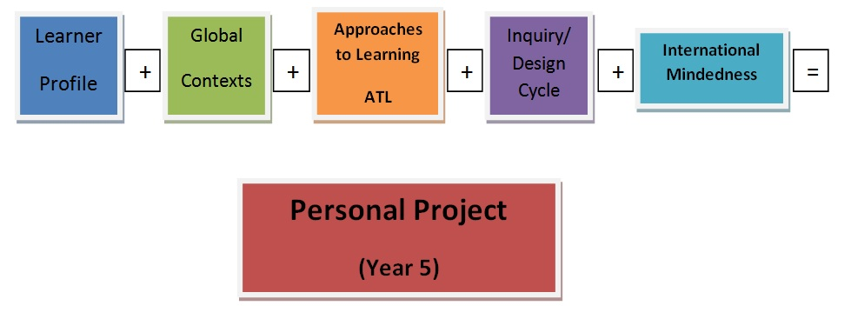
Personal Project Combines all of MYP

Slide 6
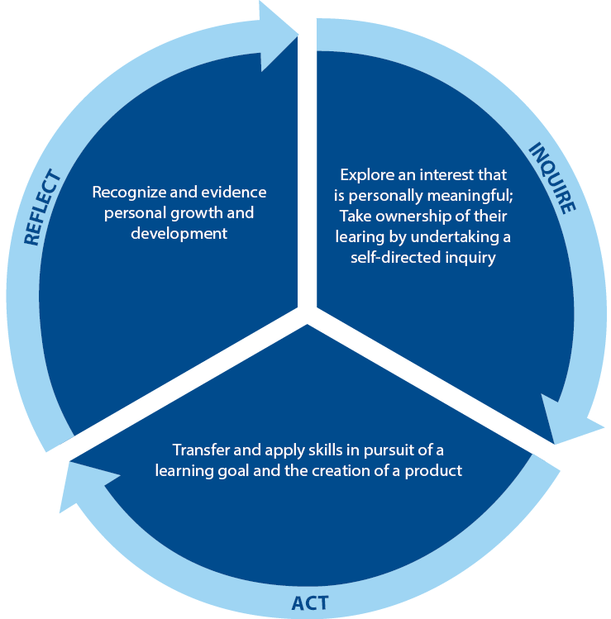
The nature of the personal project
The personal project provides an opportunity for students to undertake an independent and age-appropriate exploration into an area of personal interest.
Through the process of inquiry, action and reflection, students are encouraged to demonstrate and strengthen their approaches to learning (ATL) skills.
Notes:
Agency: Students set their own goal and choose how to achieve it. Students create their own articulation of what success will look like.
Lifelong learning: Students demonstrate and develop approaches to learning (ATL) skills. Students reflect on the impact that the project has had on themselves and/or their community.

Slide 7
The nature of the personal project
The personal nature of the project is important; the project allows students to explore an area that motivates and interests them.
Students choose what they want to focus on
Students articulate what success will look like
Students choose how to achieve their goal
Notes:
Motivation: Students explore an area that motivates and interests them.
Lifelong learning: Students demonstrate and develop approaches to learning (ATL) skills. Students reflect on the impact that the project has had on themselves and/or their community.

Slide 8
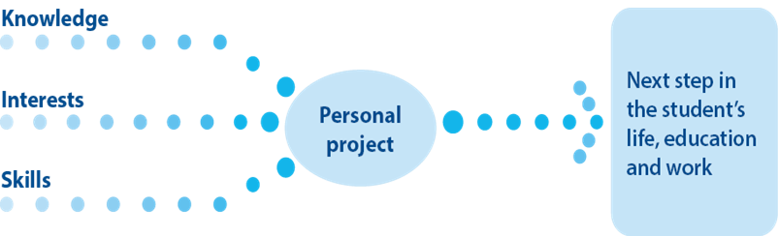
The nature of the personal project
The independent nature of the project prepares students to pursue meaningful goals in life, education and the workplace.
Notes:
Motivation: Students explore an area that motivates and interests them.
Lifelong learning: Students demonstrate and develop approaches to learning (ATL) skills. Students reflect on the impact that the project has had on themselves and/or their community.

Slide 9
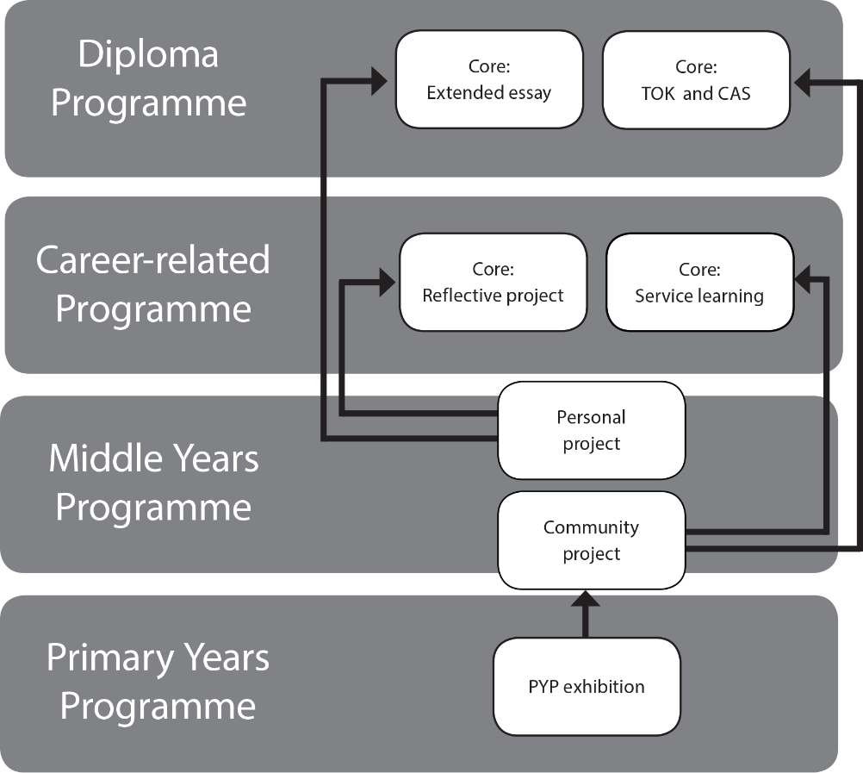
In the IB continuum
Like the PYP exhibition and the DP and CP cores, the personal project provides an excellent opportunity for students to demonstrate a consolidation of their learning in the MYP.

Slide 10
Imagine you were going to do a personal project.
What would it be about? Why?

Slide 11
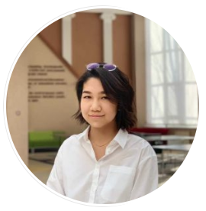
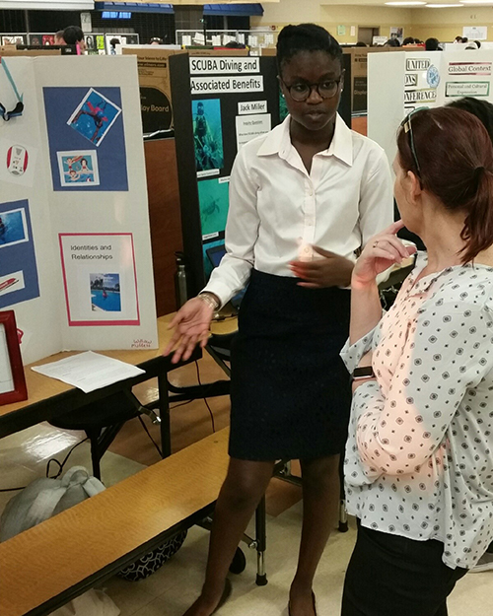
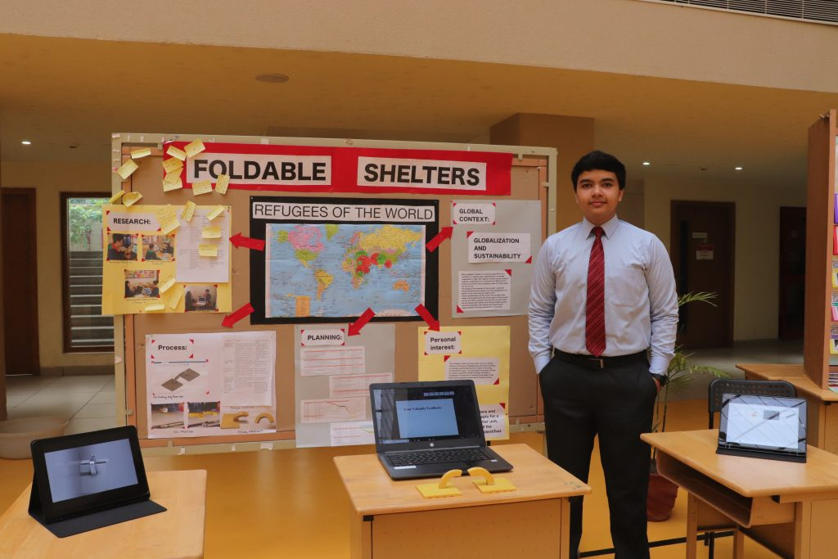
MYP student Kamilla Mazenhova chose to pursue a service-oriented personal project emphasizing the application of “maker-centred” learning to action. She collaborated with blind students at № 10 School in Astana to create a new year drama.
Rashed’s personal project provides plans for a foldable system of housing that provides a better alternative to current shelters. The rigid and anchored structures are more sustainable, safer and better temporary solutions.
Willow discusses her MYP personal project at Atlantic Community High School. She focused her project on swimming to develop her skills and share her passion for the water with other students.
Notes:
For more details about these projects, please refer to the IB blog
Rashed’s project: https://blogs.ibo.org/blog/2019/04/05/myp-projects-tackle-real-world-problems/
Willow’s project: https://blogs.ibo.org/blog/2019/04/26/diving-into-the-myp-project/
Kamilla’s project: https://blogs.ibo.org/blog/2019/03/17/personal-project-within-service-initiative-helps-in-problem-solving-and-creative-thinking/

Slide 12
What
What is the personal project?

Slide 13
The personal project
Inquiry
Action
Reflection
Process
Product
Report
Notes:
The personal project consists of three interrelated components: a process of inquiry that results in a product and a report. Collectively, these interrelated components allow students to meet the aims of the project:
Through the process of creating a product, students explore an area that is personally meaningful, take ownership of their learning in a self-directed inquiry, and transfer and apply skills in pursuit of a learning goal and the creation of a product.
The product provides a focus for exploring an interest that is personally meaningful, and a basis for recognizing and evidencing personal growth.
Finally, preparing the report is an opportunity for students to engage in a structured reflection on the process and the product, allowing them to recognize and evidence their growth and development. While the report is the only component that is assessed, the report reflects both the process and the product.

Slide 14
The stages of the personal project
Planning
Students set a learning goal.
Students set a product goal.
Applying skills
Students apply skills to achieve their learning goal.
Students apply skills to achieve their product goal.
Reflecting
Students evaluate their product against the success criteria.
Students determine success criteria for their product.
Students reflect on the impact of the personal project.
Notes:
The learning goal is what students want to learn about.
The product goal is what the students want to create.

Slide 15
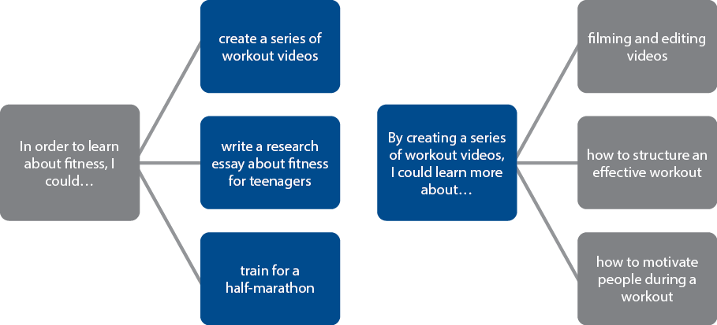
The goal
The goal consists of two interrelated components:
a learning goal and a product.
The product is what you will create and the learning goal is what you want to learn.
Notes:
While some students might begin the goal-setting process with a product in mind, other students will begin with a learning goal from which they will decide what kind of product to pursue. The learning goal that students begin with could lead to a variety of different products, just as a product could relate to a variety of learning goals.

Slide 16

The process
Students are expected to document their process. In this way, students
demonstrate their working behaviours and academic honesty.
If students have documented their process throughout, this should help them to write their reflective report at the end of the process.
Notes:
Clarifications:
Students may use a process journal to document the development of their personal project, but they are not required to do so.
Photo by William Iven on Unsplash (https://unsplash.com/photos/gcsNOsPEXfs)

Slide 17
The report
At the end of the process students document their learning in the personal project report. Here they reflect on their learning goal, the product, the skills developed as well as the impact and achievement of the project.
Planning | Applying skills | Reflecting
Students discuss what they did in their project. | Students show how ATL skills contributed to the learning goal and product. | Students report on why they did their project.

Slide 18
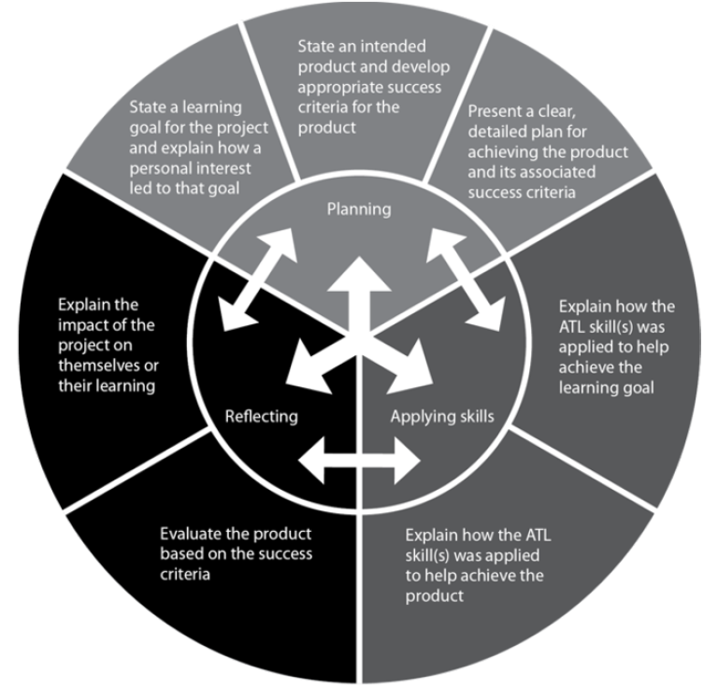
Assessment
The personal project is assessed by the school and verified by the IB. Students who complete the project get an IB-validated course result as evidence that they have met the objectives of the project.

Slide 19
How
How is the personal project implemented?

Slide 20
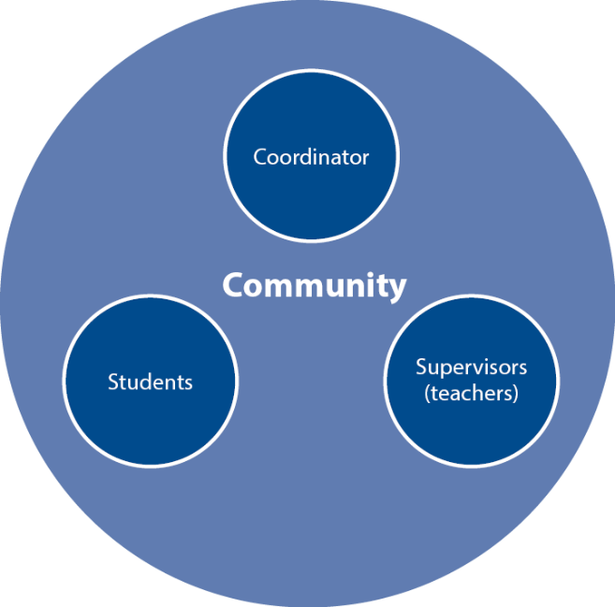
The learning community supports the personal project
Personal project coordinator
Supervisor
The community, including parents

Slide 21
The learning community supports the personal project
Project coordinator
They support supervisors and students.
They communicate expectations, timelines and procedures.
Supervisor
They provide guidance to students throughout the project.
They assess the final project submission.
Community
The librarian or resource specialist helps students with research.
Students may seek advice from experts within or beyond the school community.
They allocate a supervisor to each student.
They verify the authenticity of the student’s work.
Notes:
Please refer to the section “The role of staff” in the MYP Personal project guide for detailed roles and responsibilities.

Slide 22
Guidelines
A minimum of 25 hours outside of school time is expected for a successful project
The IB Organization is very clear that students are expected to be self directed and practice their time management skills throughout the project

Slide 23
Your Projects will be marked on 3 Objectives
Criterion A: Planning
Criterion B: Applying skills
Criterion C: Reflecting

Slide 24
What will you create?
Learning goal
Action plan
Process Journal
Product
Written report
Oral reflection (recorded)
Showcase

Slide 25
Questions?

