Slide 1
Personal project
Applying the skills

Slide 2
Applying the skills:
How will you achieve your goal?
In this stage of the project you will …
Select and apply ATL skills to work towards your learning goal
Select and apply ATL skills to work towards your product goal
Gather evidence showing how you have used the ATL skills in your project

Slide 3
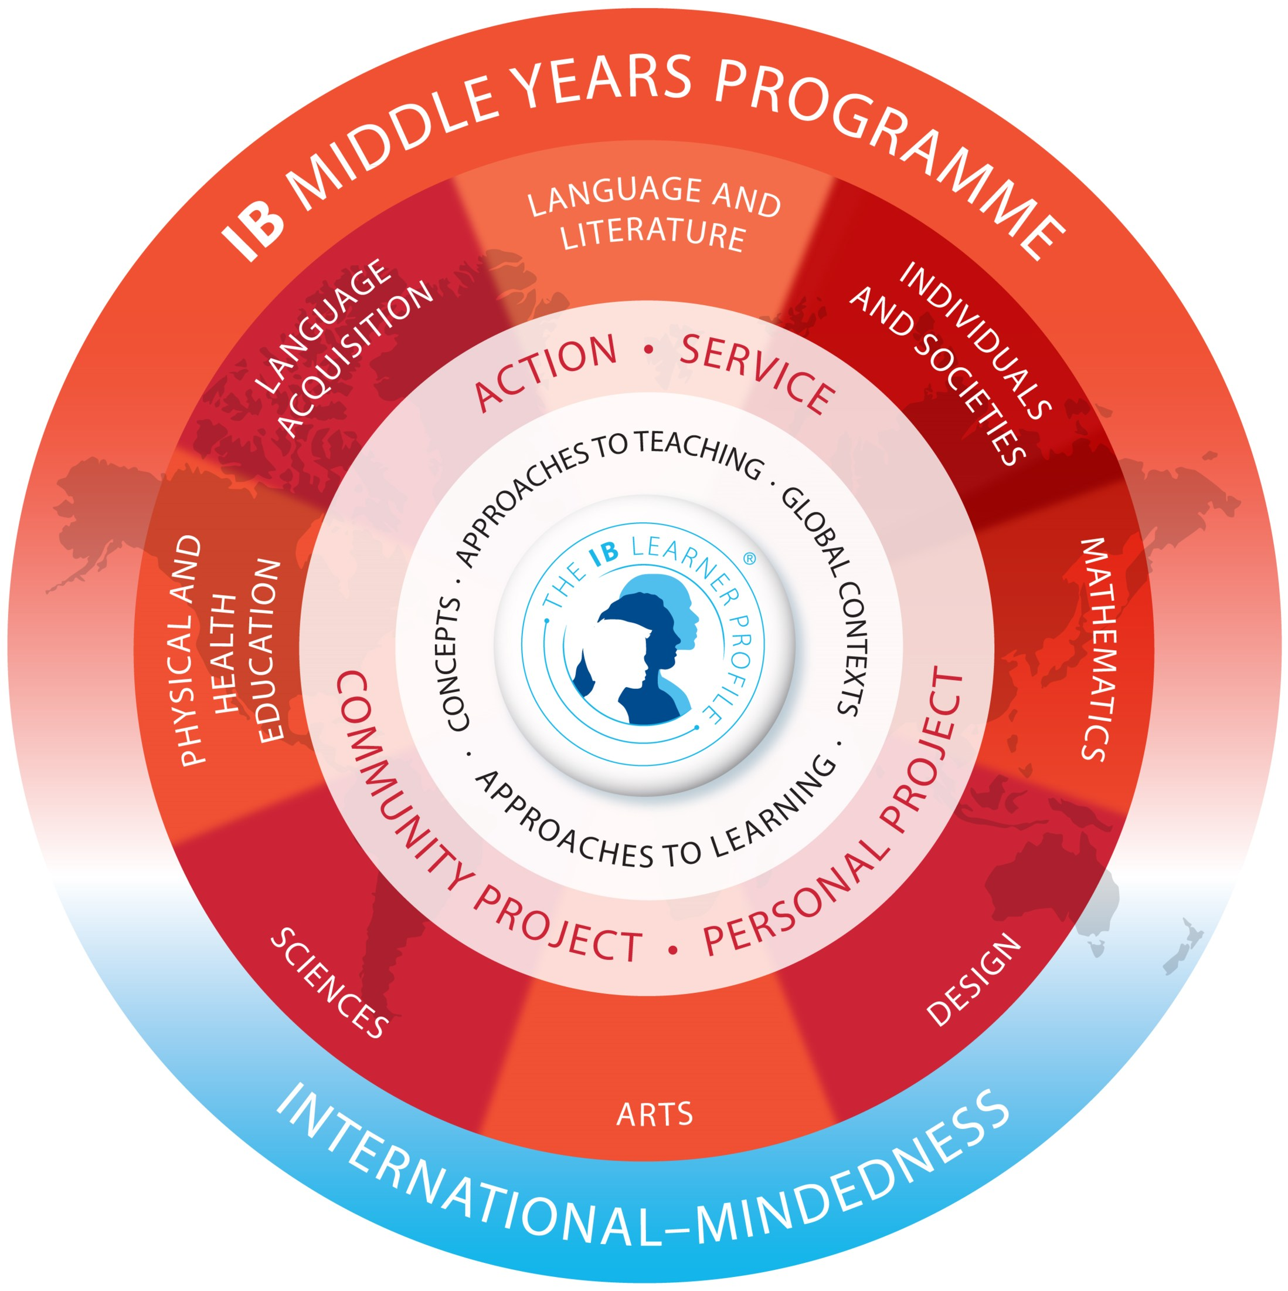
Approaches to learning
Through ATL in IB programmes, students develop skills that have relevance across the curriculum that help them “learn how to learn”.
You will use these skills during your personal project, will document them, then finally reflect on them in the report.
Notes:
MYP: From principles into practice (for use from September 2014/January 2015)

Slide 4

Activity
Working with your group, write down the five ATL categories*, then list some of the skills you have developed in your MYP courses.
For example
Research: interviews, source evaluation, analysis of existing products, OPVL, surveys, books, websites, articles, newspapers, videos, workshops, experiments ...
*Communication, social, self-management, research and thinking skills
Notes:
Photo by @clay.banks Unsplash: https://unsplash.com/photos/pNEmlb1CMZM

Slide 5

Reflect
Which of those skills will be useful as you work towards your learning goal?
Which of those skills will be useful as you work towards your product goal?
Notes:
Photo by Gaelle Marcel on Unsplash (https://unsplash.com/photos/L8SNwGUNqbU)

Slide 6

Think–pair–share
What skills am I confident in?
What skills do I think I will use in my project?
What skills will be a challenge for me?
Notes:
Photo by Joshua Earle on Unsplash (https://unsplash.com/photos/ICE__bo2Vws)

Slide 7

"When teaching and learning are visible there is a greater likelihood of students reaching higher levels of achievement"
John Hattie
Notes:
Photo by Daniel Chekalov on Unsplash (https://unsplash.com/photos/OxU08SFhPbI)

Slide 8
What could the ATL skills look like?
ATL skill cluster | Possible evidence
Communication | Correspondence with supervisor, social media posts
Collaboration | Essential agreement for group work, feedback to (or from) peers
Organization | Action plan, calendar reminders, lists, timelines
Affective skills | Lessons learned from setbacks, routines to enhance focus
Reflection | Self-evaluations, status updates
Information literacy | Lines of inquiry, annotated bibliography
Media literacy | Annotated research, Venn diagrams to compare and contrast sources
Critical thinking | Pro/con lists, data analysis
Creative thinking | Prototypes, concept sketches, visible thinking diagrams
Transfer | List of relevant prior learning, Mind Map® that connects ideas
Notes:
These are just a few possibilities. Please refer to the skill indicators in the ATL skills framework (Appendix 1 of MYP: From principles into practice) for more details.

Slide 9
In the report
At the end of the personal project, you will submit a report with a section about this phase of the project. You will need to:
explain how the ATL skill(s) was/were applied to help achieve your learning goal
explain how the ATL skill(s) was/were applied to help achieve your product
support your explanations with detailed examples and evidence.
Notes:
Examples of supporting evidence could include:
a series of inquiry questions (research skills)
sample correspondence with the project supervisor (communication skills)
screenshot of daily reminders or alerts to complete personal project tasks (self-management)
reflection about resolving a conflict (social skills)
summary of prior learning that is relevant to the project (thinking skills).

Slide 10
Gathering evidence
The ATL skills will help you reach your product goal and your learning goal. Gathering evidence of how you used the ATL skills will also support your reflection at the end of the project.
Here are some tips:
Use any format (or formats) that work for you.
Reflect regularly about what ATL skills you have used recently.
Keep a record of your reflections and include supporting evidence and example.
Notes:
Formats can be digital or hard copy, written, visual or verbal, and may be gathered across a variety of platforms such as notebooks, portfolios, folders, blogs, social media feeds or voice memos.
Please refer to the section “Gathering and curating evidence” in the MYP Personal project guide for more details.

Slide 11
Questions?

