Slide 1

Grade 10 Course Selection
A step by step process of selecting the right courses for your future.

Slide 2

You should Know
Personal Strengths and Interests
Individual Learning Needs

Slide 3
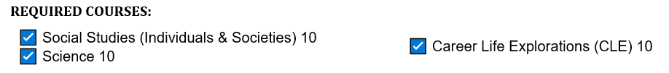
REQUIRED COURSES

Slide 4
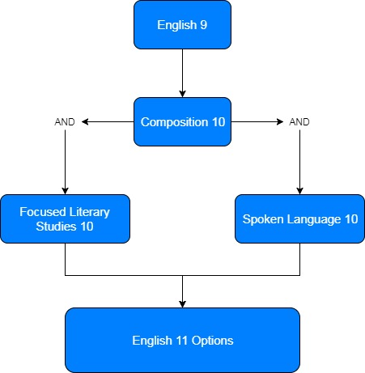
ENGLISH

Slide 5
ENGLISH

Slide 6
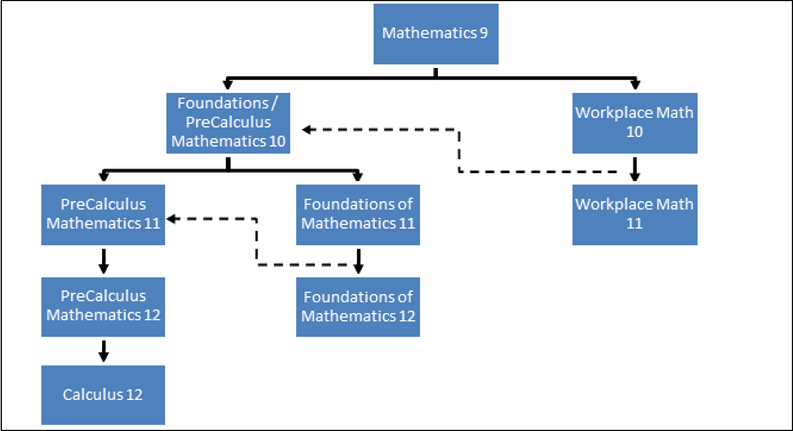
Mathematics

Slide 7

Mathematics

Slide 8
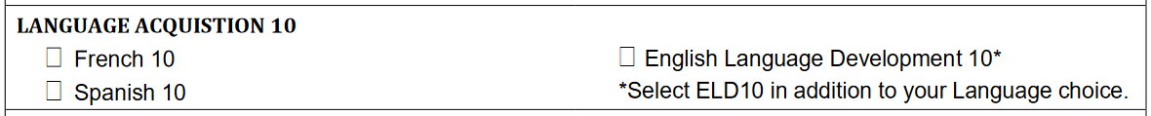

LANGUAGES
Notes:
Note that for many Post Secondary options, a Language 11 is a requirement.

Slide 9

Physical Education

Slide 10
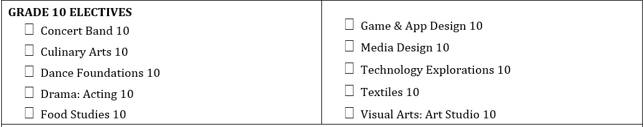
Electives

Slide 11

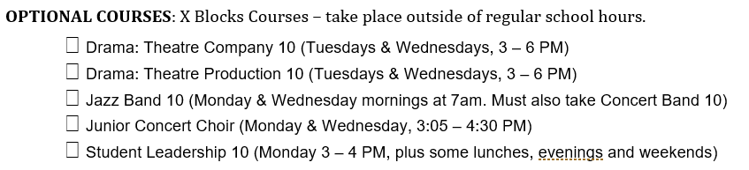
OPTIONAL COURSES

Slide 12
FINALLY . . .
Count your courses – 8 courses and 2 alternates
Self Check #1 – Can I handle this workload? Am I challenging myself?
Self Check #2 – Does this open the right doors for my future?

Slide 13

Your Turn
Homework tonight
Talk to your family – the choices seem simple, but these are major life decisions.
Log into MyEdBC and enter your selections.
Place the worksheet in your school bag to return to your teacher tomorrow.
https://www.myeducation.gov.bc.ca/aspen/logon
OR Google MyEdBC login
Your Student #
Your password
Do this tonight!!!

Slide 14
Logging IN
Your Student #
Your password
If you haven't logged in before, come to the office afterschool today to get your login.

Slide 15
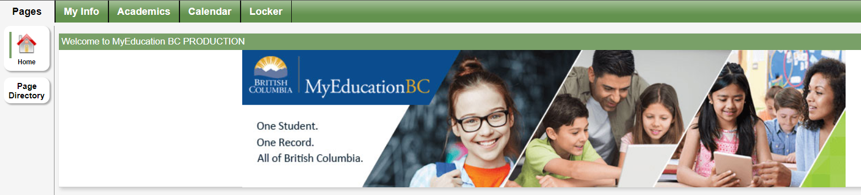
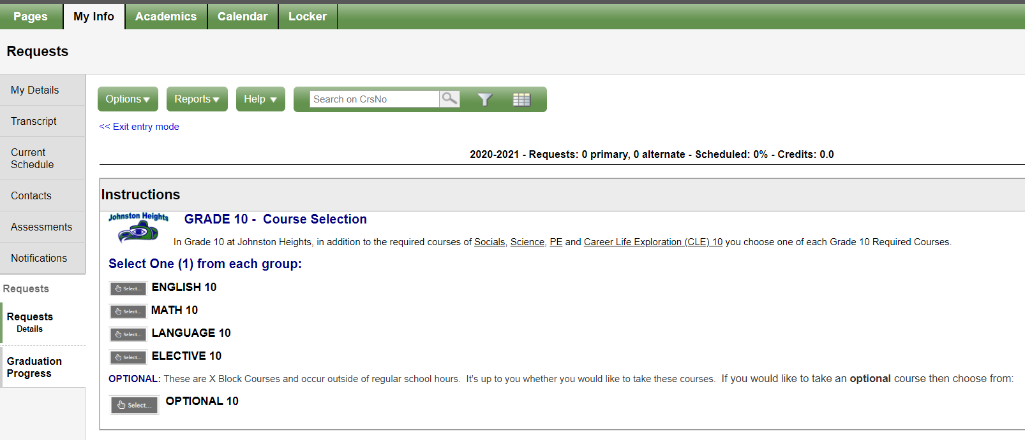
Accessing requests
1
2

Slide 16
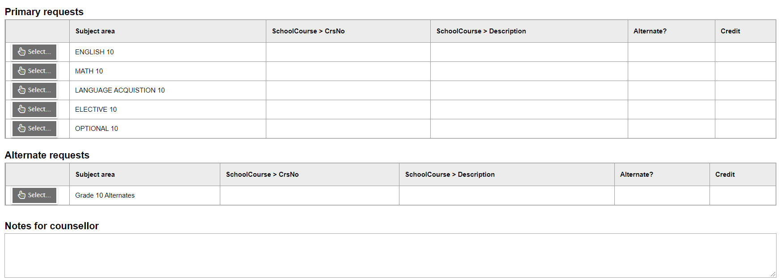
Entering requests
1
2

Slide 17
Entering requests
1
2
3

Slide 18
THURSDAY
Lab visits in C1 Thursday – All course selection in Learning Commons
* Ms.Hutchinson’s will be done separately in her ADST class Thursday
* Mr.Filiatrault’s will be collected in class on Thursday (Paper copies)
8:30 – 8:55​ | Fang​ | Zannata​ | Smith​
8:55 – 9:20​ | Leung​ | Sumpton​ | Scozzafava​
9:20 – 9:45​ | Keller​ | Zappone​ | Douglas​

Slide 19


