Slide 2
Bullying

Slide 3
What is bullying?
Hurting someone on purpose
Picking on kids who smaller, weaker, or because they are different
Picking on kid who won’t stand up for themselves
Teasing and calling names
Attacking and threatening physically, socially and emotionally
Using strength or power or numbers of people to hurt or scare you

Slide 4
OVER and OVER AND OVER

Slide 5
Who can be bullies?
Boys
Girls
Anyone who uses
their physical strength
Power through their age
Power through their numbers of people
Their social power

Slide 6
What does Bullying do?
Bullying can make kids feel:
Scared
Nervous
Threatened
Unwanted
Depressed
Sad
Worried

Slide 7
Bullying is not:
Two kids having a disagreement or arguing
Someone (one person) not wanting to play with you
Playing rough on the playground
Calling names once in a while to many different people
These are not nice, not good behaviour, and need to be solved.

Slide 8
So what can we do?
Tell an adult and get help!
Be a leader and stick up for each other
Don’t leave someone alone
Don’t take part
Don’t be a BYSTANDER!

Slide 9
Let’s work on this together

Slide 10
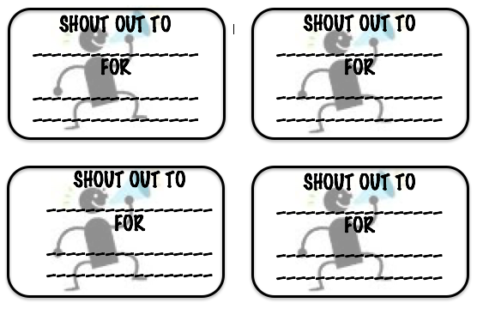
Shout Outs
When you see someone doing something you see is…..
Helpful
Kind
Friendly

Slide 11
random Acts of Kindness

Slide 12
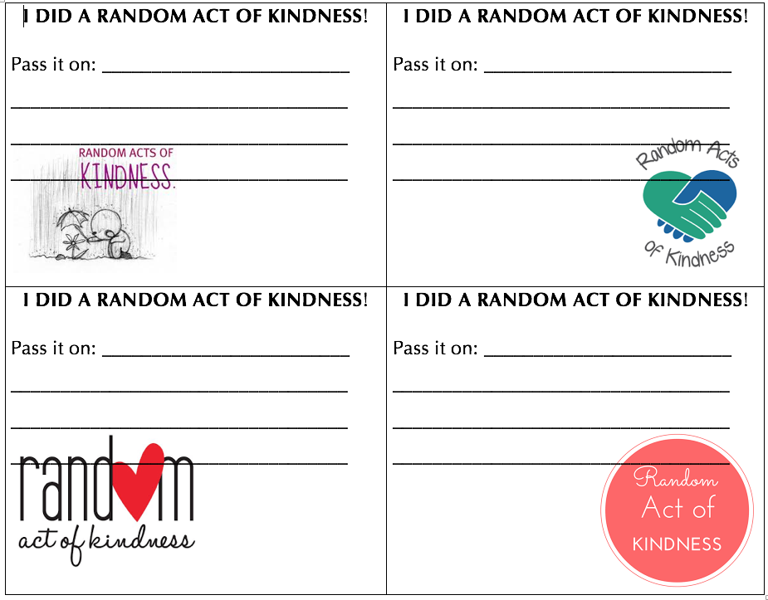
When you do an act of kindness for someone else….

Slide 13
Let’s fill our school with kindness!

